Slide 1
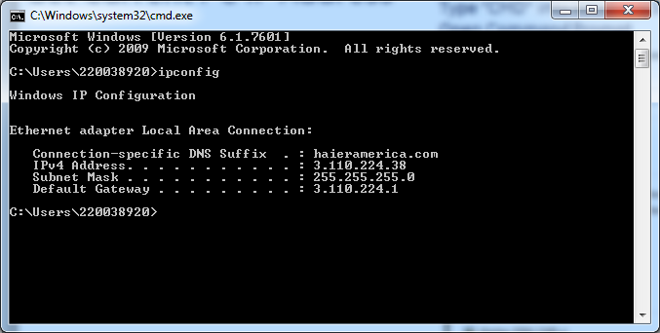
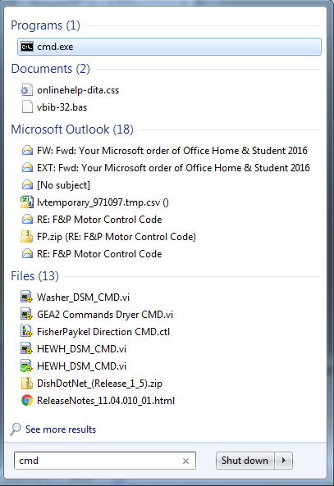
Get Current PC IP Address
Type “CMD” into Windows Search Bar. Open Command Prompt
Type “ipconfig” and press Enter.
Write down this information. You will need to change the IP back to this when your are finished with device setup.

Slide 2
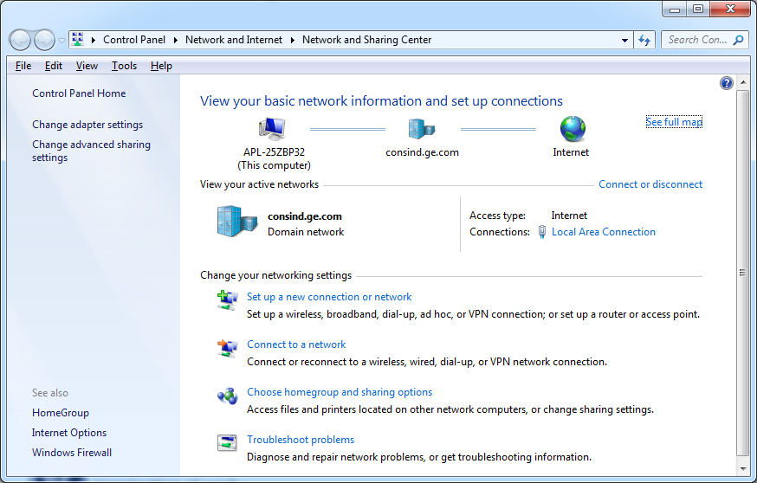
Change IP Address on PC

Slide 3
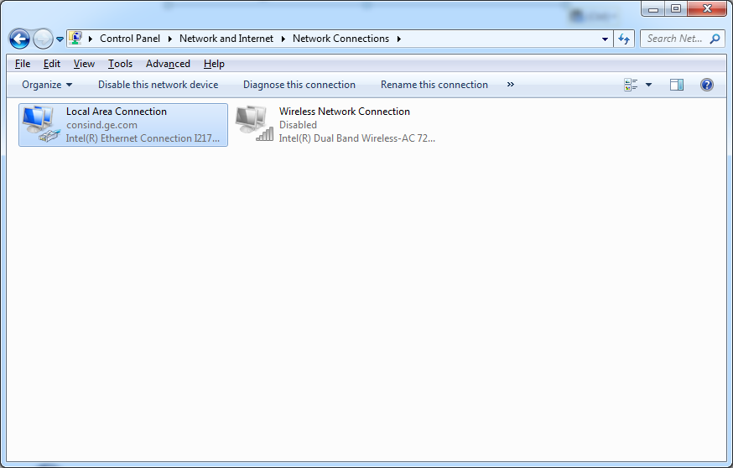
Change IP Address on PC
Right Click – Properties
(If you see prompt – Click YES

Slide 4
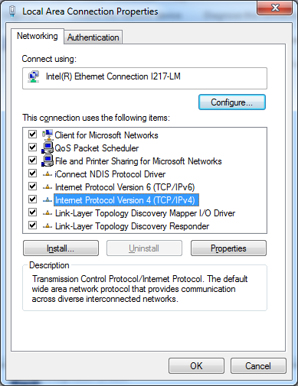
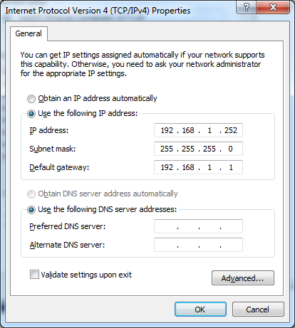
Change IP Address on PC
Test systems have “Static IP” addresses. You need to write this down so you can change it back. If, the “Obtain address automatically” is checked…you need to change back to this when you are finished
Make Changes…Click OK

Slide 5
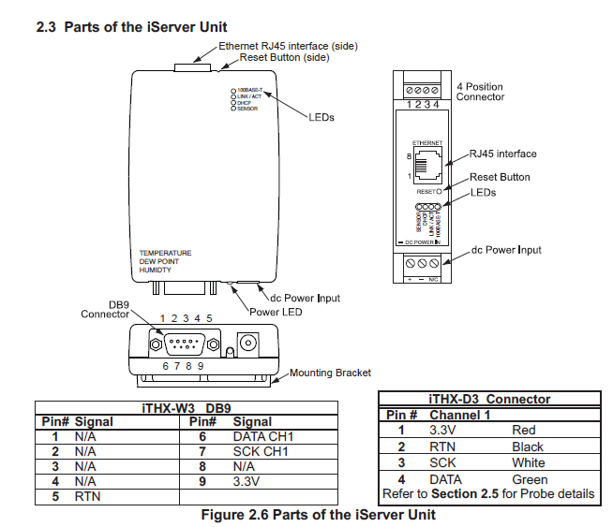
Connecting to the Device
Plug RJ45 into PC
You will need to hold the reset button for a few seconds. Then wait for the lights to start blinking
Press the reset button. This
Will reset the IP to 192.168.1.200
(This number is also shown on device)

Slide 6
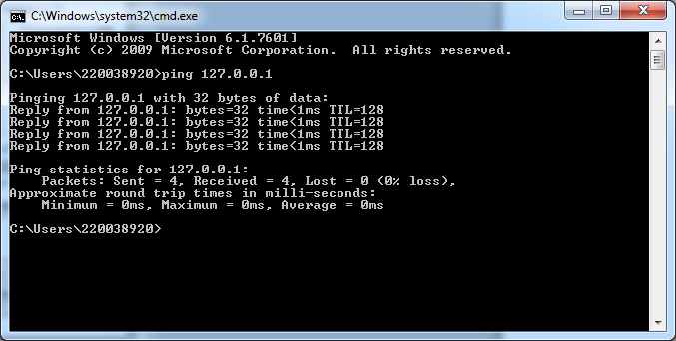
Type “CMD” into Windows Search Bar. Open Command Prompt
PING the device to make sure you get a response. Type “ping 192.168.1.200”. The response should be similar to above.

Slide 7
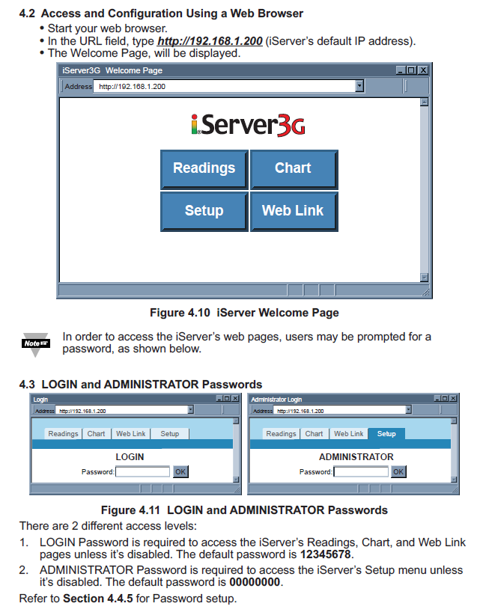
Type 192.168.1.200 into web browser (Internet Explorer)..Chrome might not work.
There are two passwords as shown below

Slide 8
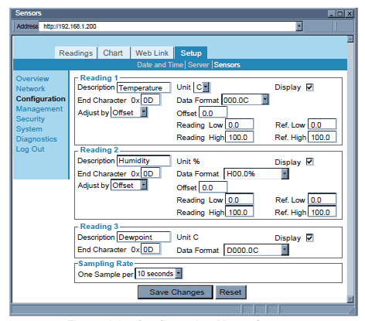
Make sure the units are set to Degrees F

Slide 9
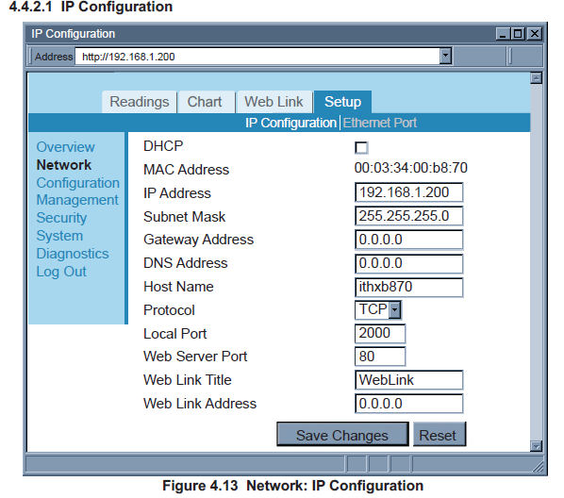
Go to “Setup” and change the IP address. You will need to “Save and Reboot” the device (Depending on the device, this screen can look different. It is there..just look for it.
Change the IP Address to the below:
Dish DOE Station 1:
IP Address 10.0.3.190
Subnet Mask 255.255.255.0
Gateway Address 10.0.3.1
Dish DOE Station 2:
IP Address 10.0.3.191
Subnet Mask 255.255.255.0
Gateway Address 10.0.3.1
Dish DOE Station 3:
IP Address 10.0.3.192
Subnet Mask 255.255.255.0
Gateway Address 10.0.3.1

Slide 10
Open the command prompt and make sure you can ping: (You can only do one device at a time if it’s the only one plugged into PC
ping 10.0.3.190
Ping 10.0.3.191
Ping 10.0.3.192
Dish DOE Station 1:
IP Address 10.0.3.190
Subnet Mask 255.255.255.0
Gateway Address 10.0.3.1
Dish DOE Station 2:
IP Address 10.0.3.191
Subnet Mask 255.255.255.0
Gateway Address 10.0.3.1
Dish DOE Station 3:
IP Address 10.0.3.192
Subnet Mask 255.255.255.0
Gateway Address 10.0.3.1

Slide 11
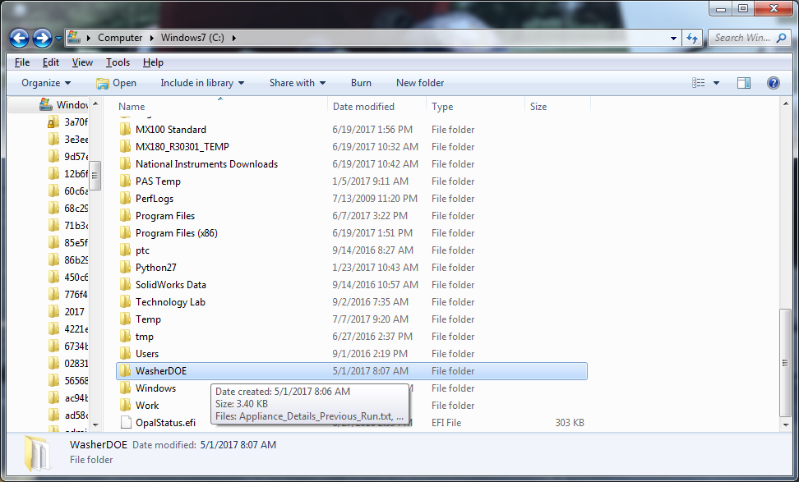
Check DOE software IP address
Open C: Drive and Washer DOE

Slide 12
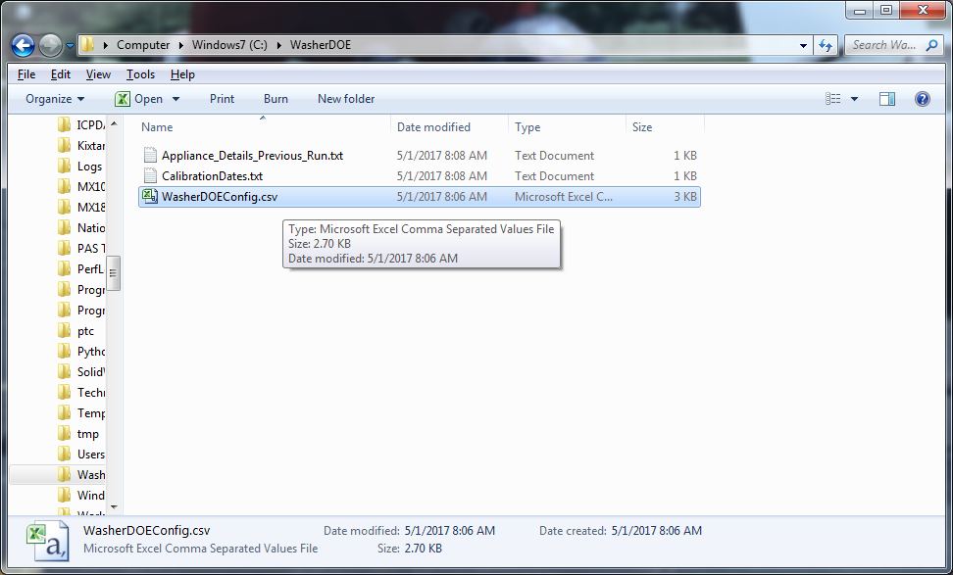
Open Config file

Slide 13
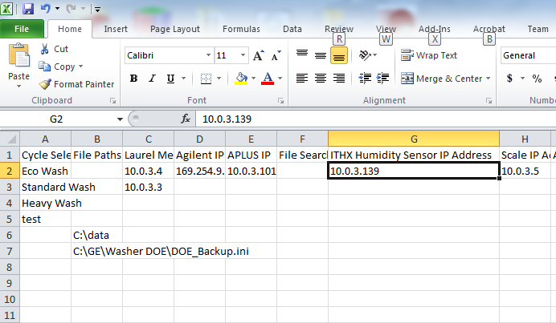
Insert the correct IP address here
Station 1:10.0.3.190
Station 2:10.0.3.191
Station 3:10.0.3.192

